Slide 1

VSB - Partial Discharge Fault Detection in Covered Conductors
A Case Study in building Machine Learning Binary
Classification Models for Unbalanced Classes
Jeffrey Egan / 13 March 2019

Slide 2
What are we covering here?
This tech talk will cover the signal processing and machine learning modeling tasks completed to identify partial discharge faults present in covered conductors in real environments. Partial discharge faults are power line degradations that will eventually result in power outages or fires. Identifying them is key to reducing maintenance costs and preventing power outages.
The discussion includes signal processing topics relevant to useful feature extraction from noisy signals and data - features used to train machine learning models.
Machine Learning discussions cover binary classification models, evaluation criteria, and model tuning required to train effective models when the classes are heavily unbalanced.
Notes:
https://en.wikipedia.org/wiki/Kaggle
https://www.kaggle.com/

Slide 3

First, what is Kaggle?
Kaggle is an online community of data scientists and machine learners.
Kaggle allows users to:
Find and publish data sets.
Explore and build models in a web-based data-science environment.
Work with other data scientists and machine learning engineers.
Enter competitions to solve data science challenges.
Kaggle got its start by offering machine learning competitions and now also offers a public data platform, a cloud-based workbench for data science, and short form Artificial Intelligence education.
Google acquired Kaggle on 8 March 2017.
Notes:
https://en.wikipedia.org/wiki/Kaggle
https://www.kaggle.com/

Slide 4
Challenge: Partial Discharge Fault Detection
Overhead power lines run for hundreds of miles to supply power to cities. These great distances make it expensive to manually inspect the lines for damage that doesn't immediately lead to a power outage (like tree branches falling on lines).
These modes of damage lead to a phenomenon known as partial discharge — an electrical discharge which does not bridge the electrodes between an insulation system completely.
Partial discharges slowly damage the power line, so left unrepaired they will eventually lead to a power outage or start a fire.
The challenge is to detect partial discharge patterns in signals acquired from these power lines with a new meter designed at the ENET Centre at VŠB. Effective classifiers using this data will make it possible to continuously monitor power lines for faults – helping to reduce maintenance costs and prevent power outages.
Notes:
https://www.kaggle.com/c/vsb-power-line-fault-detection
Medium voltage overhead power lines run for hundreds of miles to supply power to cities. These great distances make it expensive to manually inspect the lines for damage that doesn't immediately lead to a power outage, such as a tree branch hitting the line or a flaw in the insulator. These modes of damage lead to a phenomenon known as partial discharge — an electrical discharge which does not bridge the electrodes between an insulation system completely. Partial discharges slowly damage the power line, so left unrepaired they will eventually lead to a power outage or start a fire.
Your challenge is to detect partial discharge patterns in signals acquired from these power lines with a new meter designed at the ENET Centre at VŠB. Effective classifiers using this data will make it possible to continuously monitor power lines for faults.
ENET Centre researches and develops renewable energy resources with the goal of reducing or eliminating harmful environmental impacts. Their efforts focus on developing technology solutions around transportation and processing of energy raw materials.
By developing a solution to detect partial discharge you’ll help reduce maintenance costs, and prevent power outages.

Slide 5
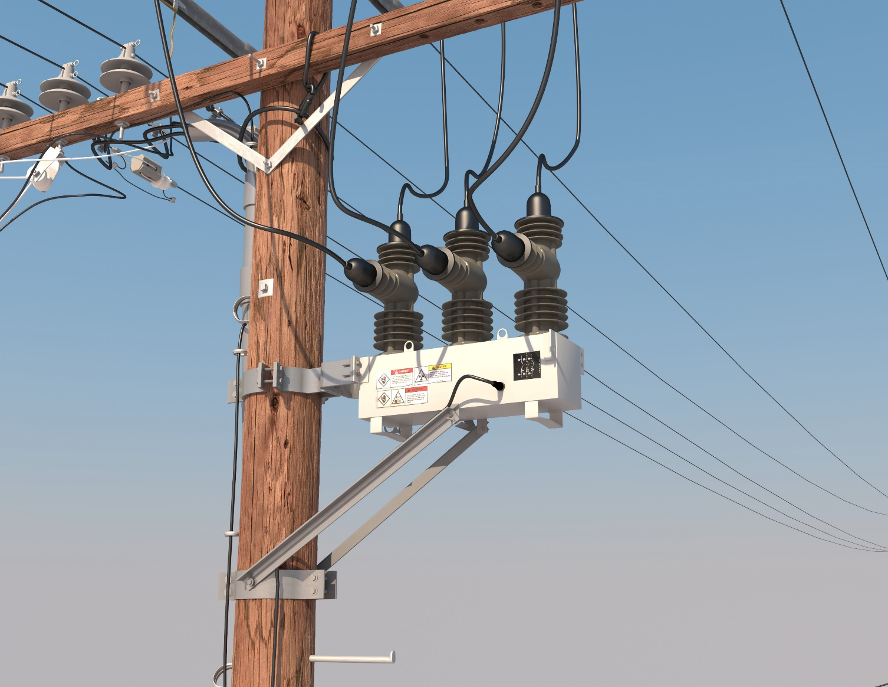
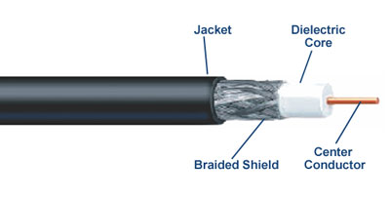
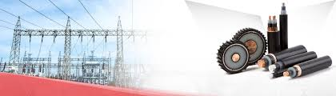
Visual Aides – Anatomy of a Covered Conductor

Slide 6
Examination Reveals Highly Unbalanced Data
All Provided Data: Labeled & Unlabeled
Labeled Training Set: 2,904 Measurements = 8,712 Signals (only 30% of data is labeled)
Unlabeled Test Set: Perform Binary Classification: 6,779 Measurements = 20,337 Signals
Occurrence of Faults and Non-Faults in Labeled Data
8187 Signals without Fault, 213 Signals with Fault (only 2.5% of labeled signals have faults!)
Grouping of Signal Faults per Measurement
Measurements with no faults present: 2710 (93.3% of measurements exhibit no fault)
Measurements with fault present in only 1 phase: 19 (9.7% of cases where faults present)
Measurements with faults present in 2 of 3 phases: 19 (9.7% of cases where faults present)
Measurements with faults present in all 3 phases: 156 (80.4% of cases where faults present)
Notes:
Analogous to the scales of data they’re working with.
Incredibly unbalanced data set!
Also while submission requires a per-signal classification, it appears that faults present in signals are not entirely independent events (e.g. one faulty signal in a measurement has > 90% chance of having other faults.

Slide 7
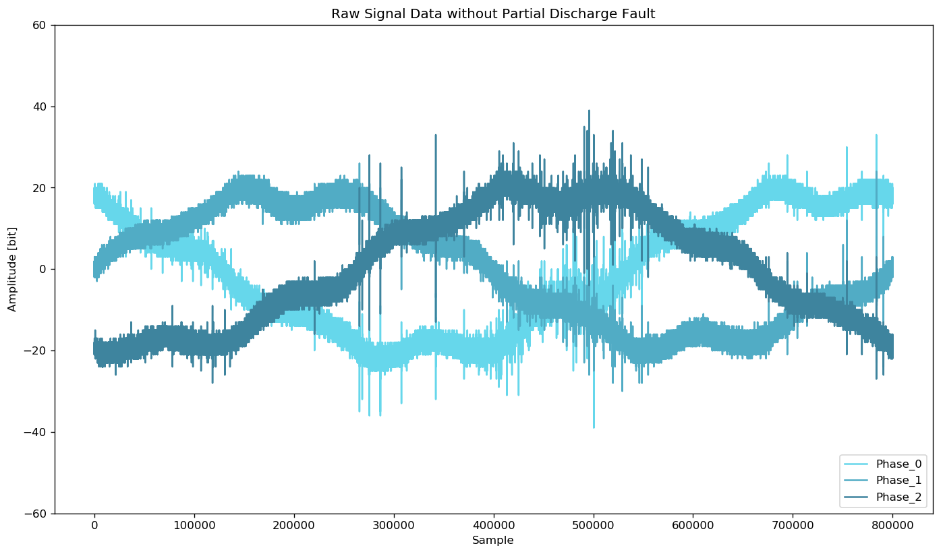
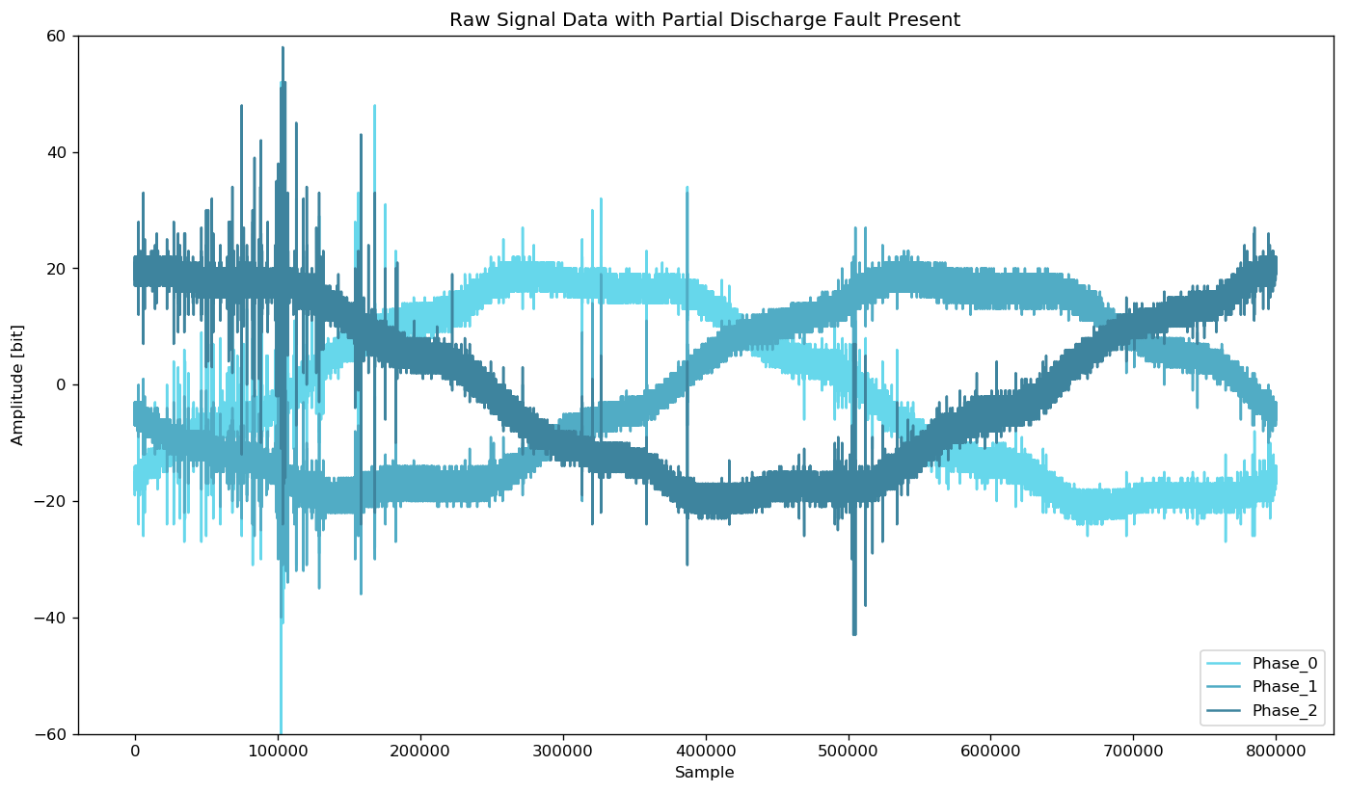
Sample Measurements with 3 Phase Signals
Each signal (phase) contains 800,000 measurements of a power line’s voltage, taken over 20 milliseconds.
For signal processing, that means each signal data set has a sample rate of 40 million samples per second.
The underlying electric grid operates at 50Hz, this means each signal covers a single complete grid cycle.

Slide 8
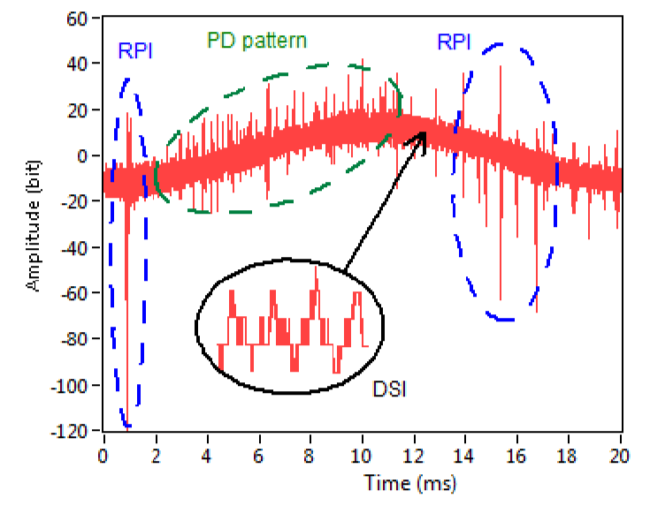
Detecting Partial Discharges is Difficult
PD Pattern Observed alongside other Noise Sources
Many other sources of noise could be falsely attributed to partial discharge.
Ambient and Amplifier Noise
PD: Partial Discharge Fault Pattern
DSI: Discrete Spectral Interference
E.g. Radio Emissions, Power Electronics
RPI: Random Pulses Interference
Lightning, Switching Operations, Carona
Figure from Reference [1]
Notes:
Misak, S., et al. “A Complex Classification Approach of Partial Discharges from Covered Conductors in Real Environment.” IEEE Transactions on Dielectrics and Electrical Insulation, vol. 24, no. 2, 2017, pp. 1097–1104., doi:10.1109/tdei.2017.006135.
The inherit difficulty with coding detection logic, makes this problem an excellent candidate for exploration and addressing with machine learning.

Slide 9
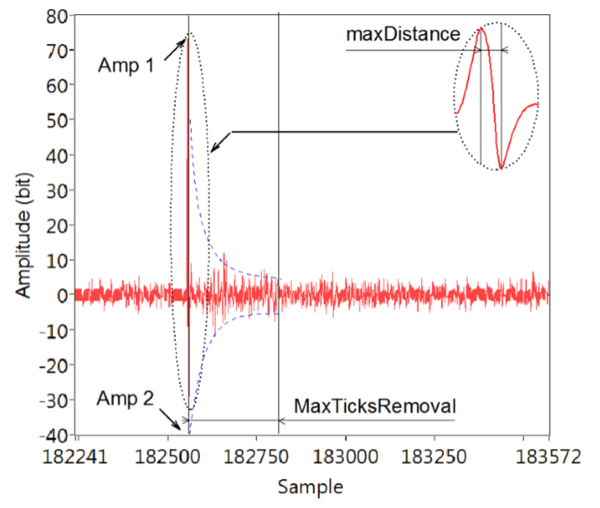
Identify and Cancel Carona Discharge Peaks
Carona Discharge Peak Detail
A corona discharge is an electrical discharge brought on by the ionization of a fluid such as air surrounding a conductor that is electrically charged.
Spontaneous corona discharges occur naturally in high-voltage systems unless care is taken to limit the electric field strength.
A corona will occur when the strength of the electric field (potential gradient) around a conductor is high enough to form a conductive region, but not high enough to cause electrical breakdown or arcing to nearby objects.
Figure from Reference [1]
Notes:
https://en.wikipedia.org/wiki/Corona_discharge

Slide 10
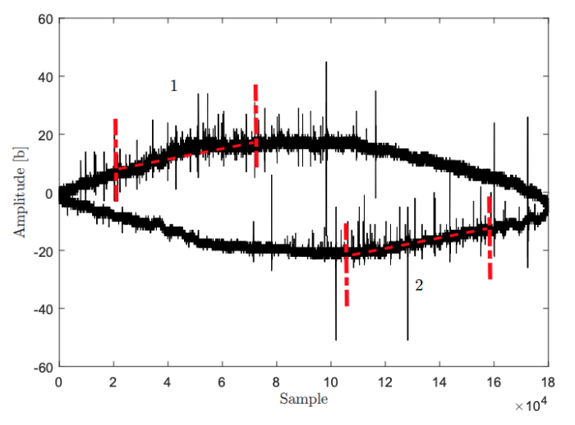
Focus on Portions of the Sinusoid with Rising Amplitude for Improved PD Detection
Sections of Sinusoidal Shape (1,2) with the Statistically Highest Occurrence of PD pulses
One of the most common fundamental features of the PD pattern is that it occurs on the rising amplitude edges of the sinusoidal curve.
During feature extraction, this allows omission of half of the signal data points – increasing processing efficiency.
Running feature extraction on the high-probable region also increases the model’s ability to detect true faults and avoid false positives.
Figure from Reference [2]

Slide 11
Overview of the Signal Processing Approach
Discrete Wavelet Transform to Remove Spectral Interference and Ambient Noise
Daubechies 4 Wavelet (db4)
Fit a Sinusoidal Function to the DWT Signal and Detect the PD-Probable Region
Use an Nth Discrete Difference to De-Trend the Function
First-order has proven sufficient
Perform Peak Detection and Subsequently Cancel of False Peaks
Peak Detection using Fixed Amplitude Threshold
Cancel High Amplitude Peaks, and Peaks Attributed to Corona Discharge
Raw Signal
Fit Sinusoid & Detect PD-Probable Region
Nth Discrete Difference Detrending
Peak Detection
False Peak Cancellation
Extract Features
Discrete Wavelet Transform

Slide 12
Examining the Raw Signal Data

Slide 13
Examining the Raw Signal Data

Slide 14
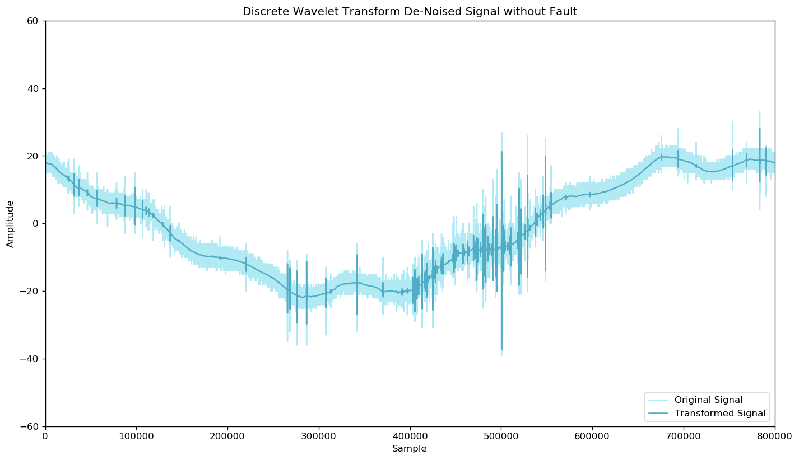
Remove DSI & Ambient Noise with DWT

Slide 15
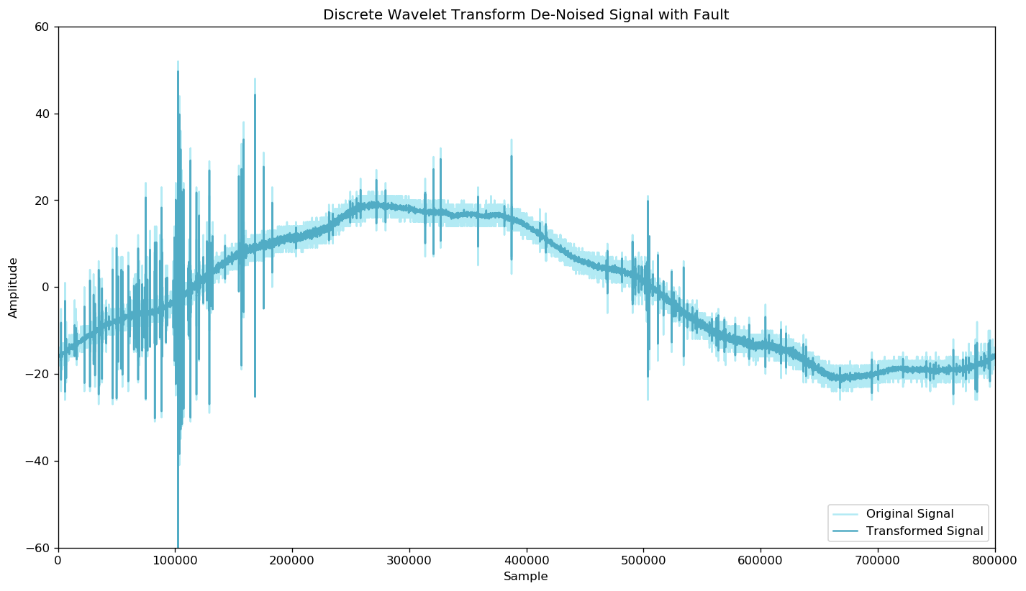
Remove DSI & Ambient Noise with DWT

Slide 16
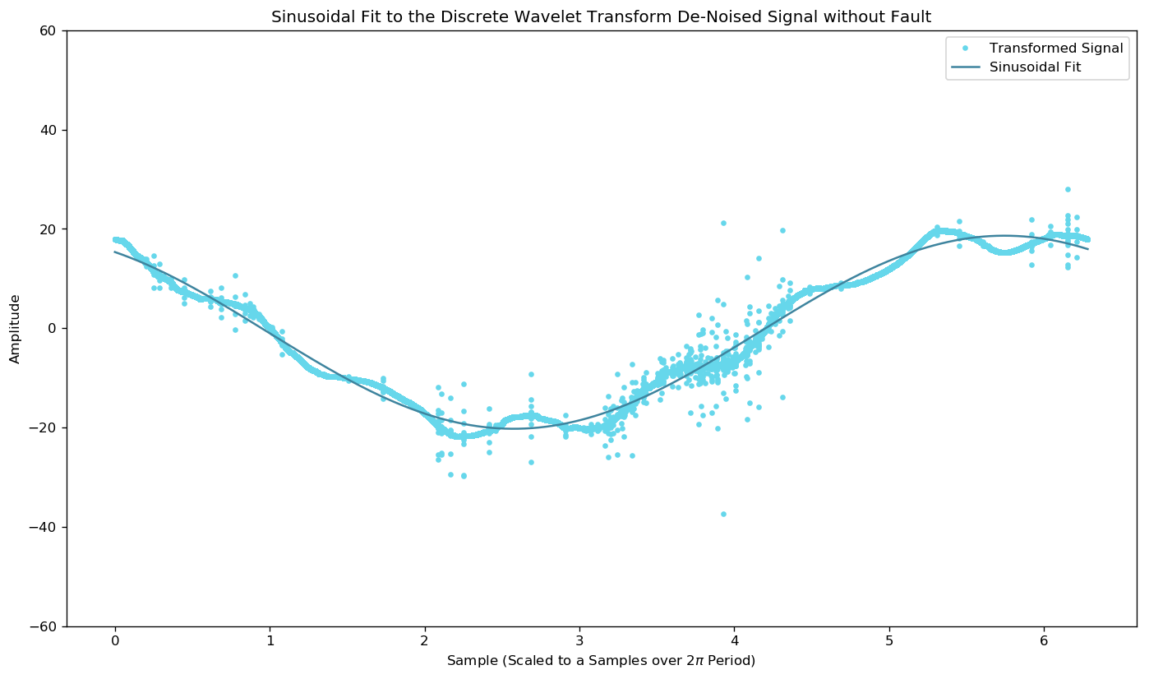
Fit a Sinusoidal Function to the DWT Signal

Slide 17
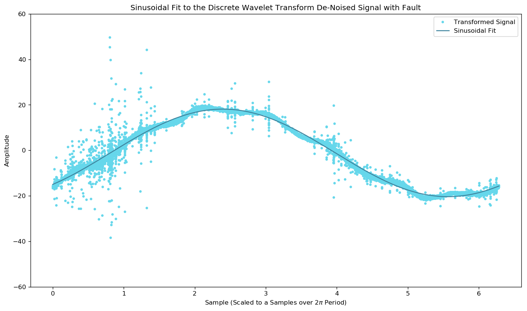
Fit a Sinusoidal Function to the DWT Signal

Slide 18
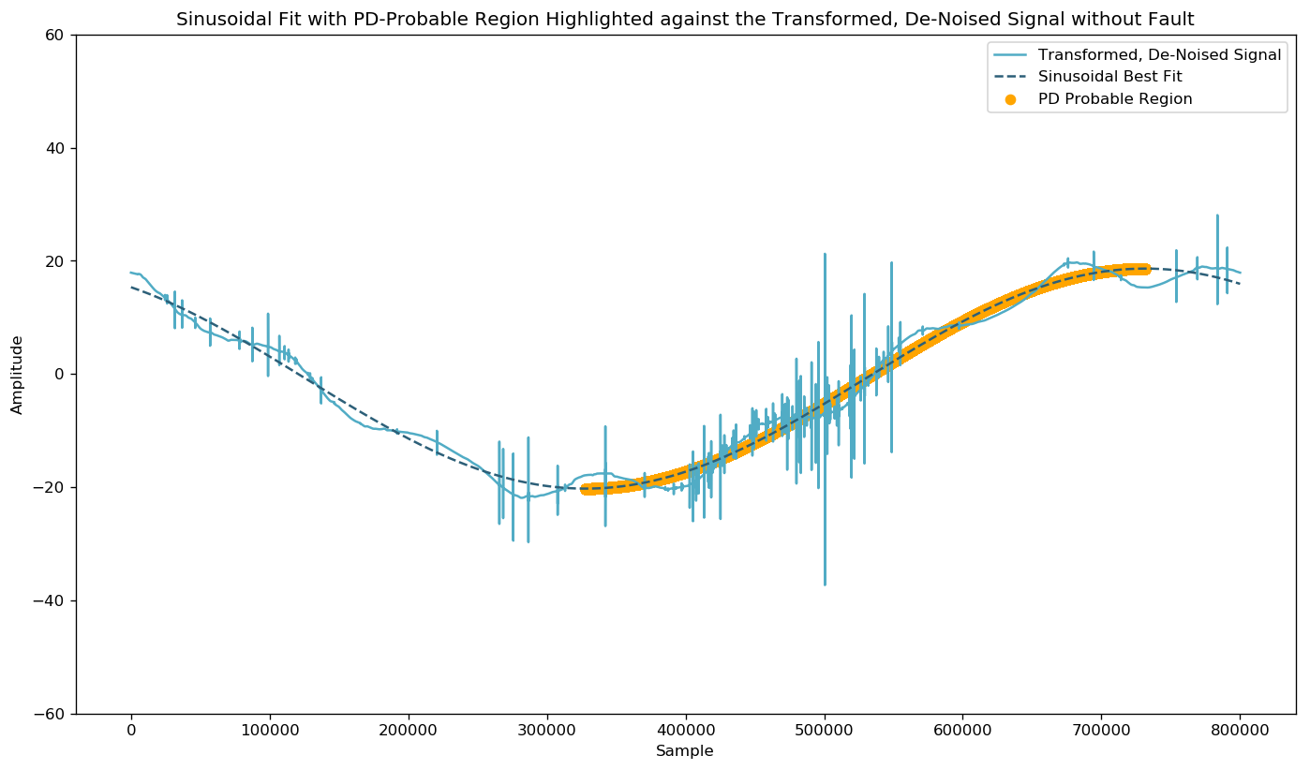
Use Sinusoid to Identify PD-Probable Region

Slide 19
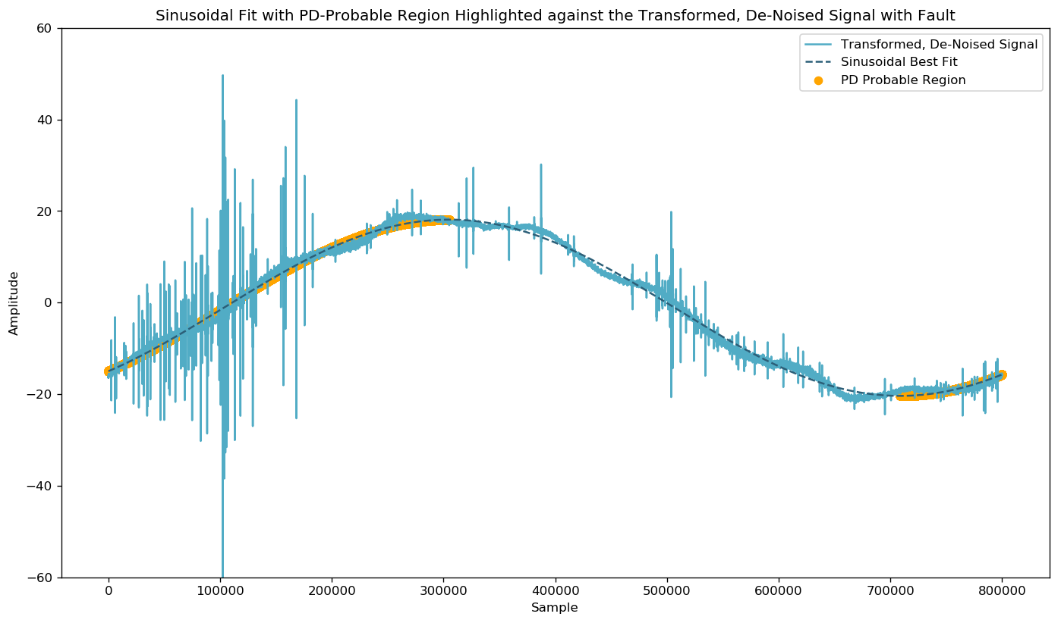
Use Sinusoid to Identify PD-Probable Region

Slide 20
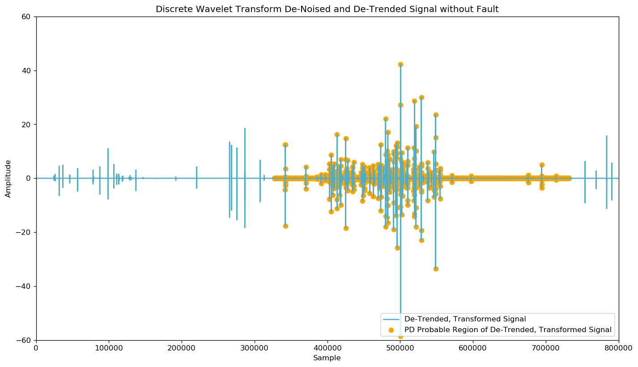
Detrend Signal to Remove Sinusoidal Element

Slide 21
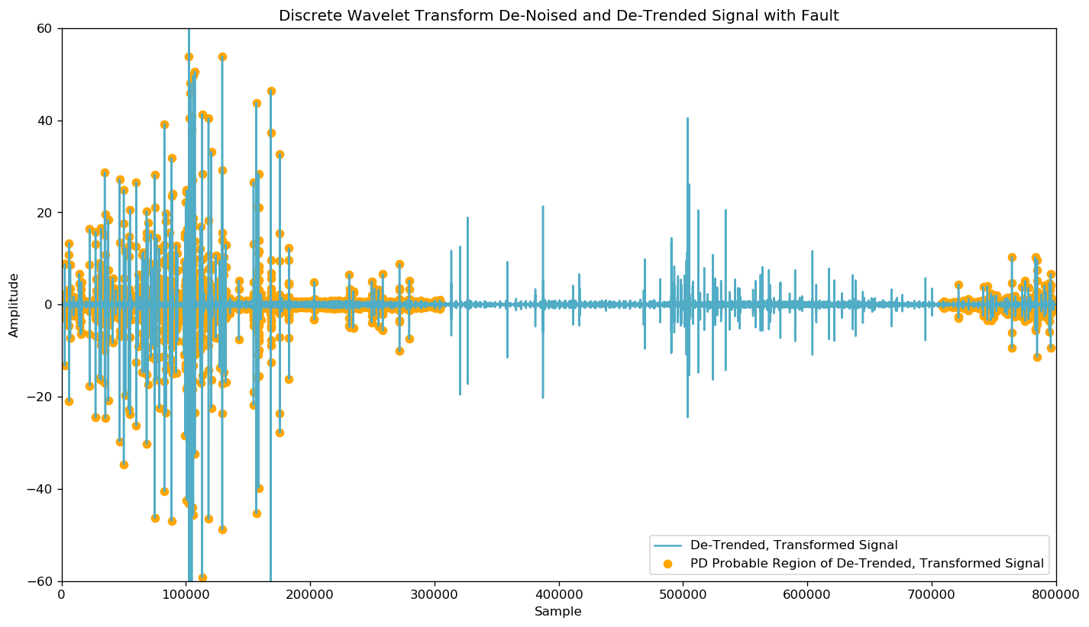
Detrend Signal to Remove Sinusoidal Element

Slide 22
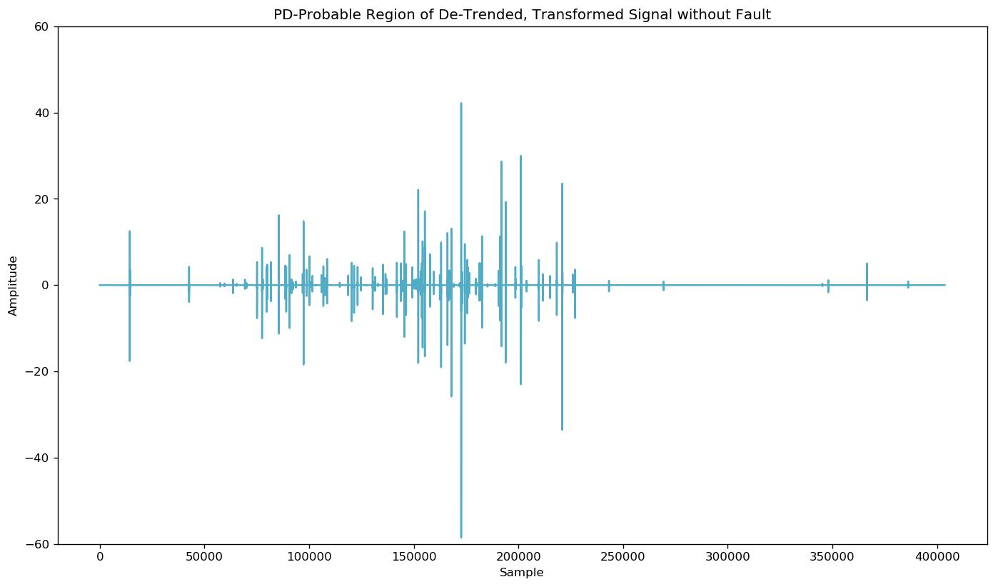
Trim to PD-Probable Region of Detrended Data

Slide 23
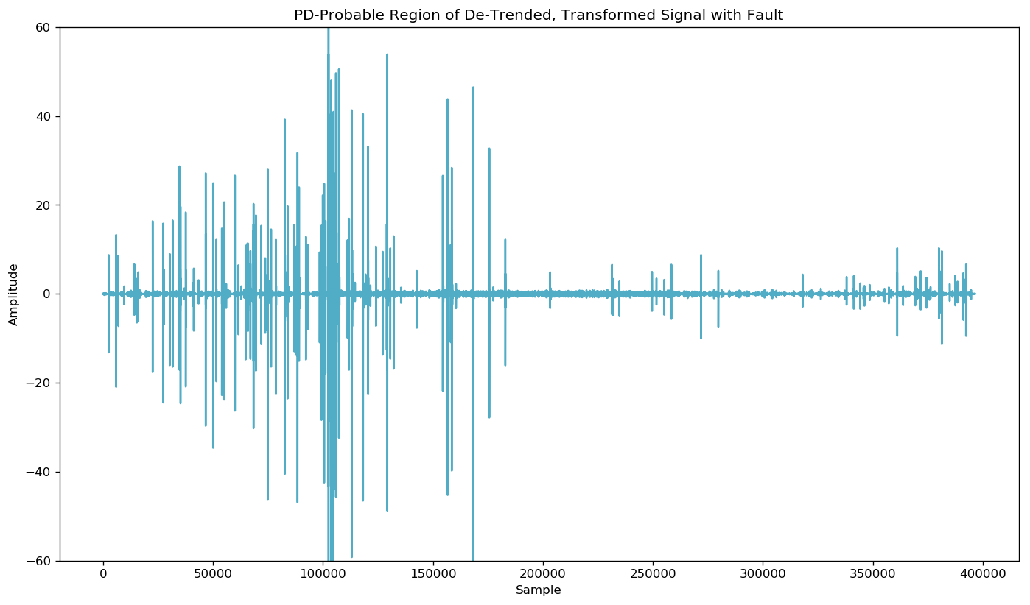
Trim to PD-Probable Region of Detrended Data

Slide 24
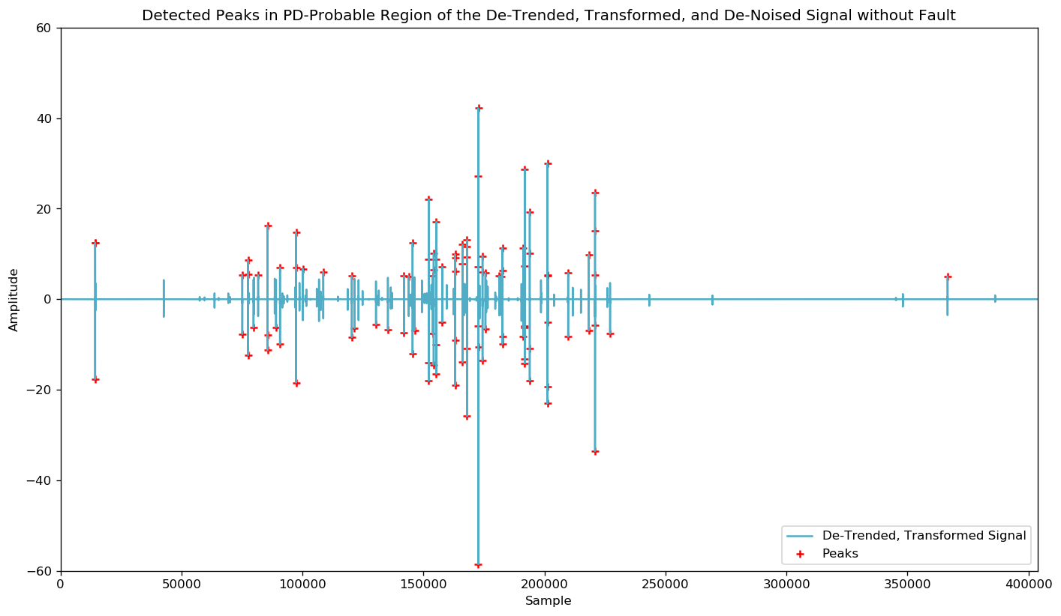
Run Peak Detection on PD-Probable Region

Slide 25
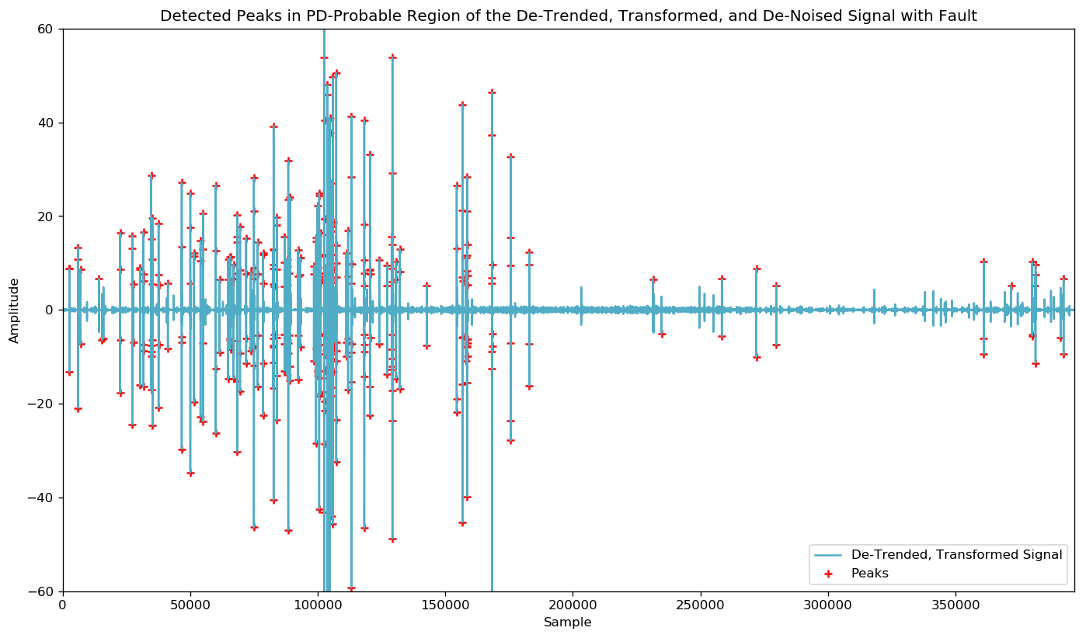
Run Peak Detection on PD-Probable Region

Slide 26
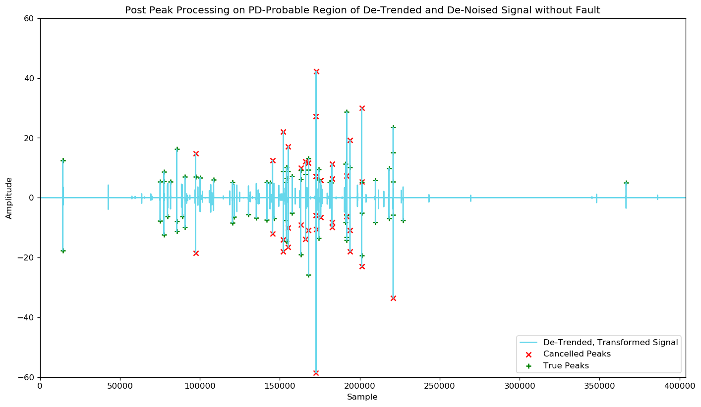
Cancel False Peaks Before Processing Signals

Slide 27
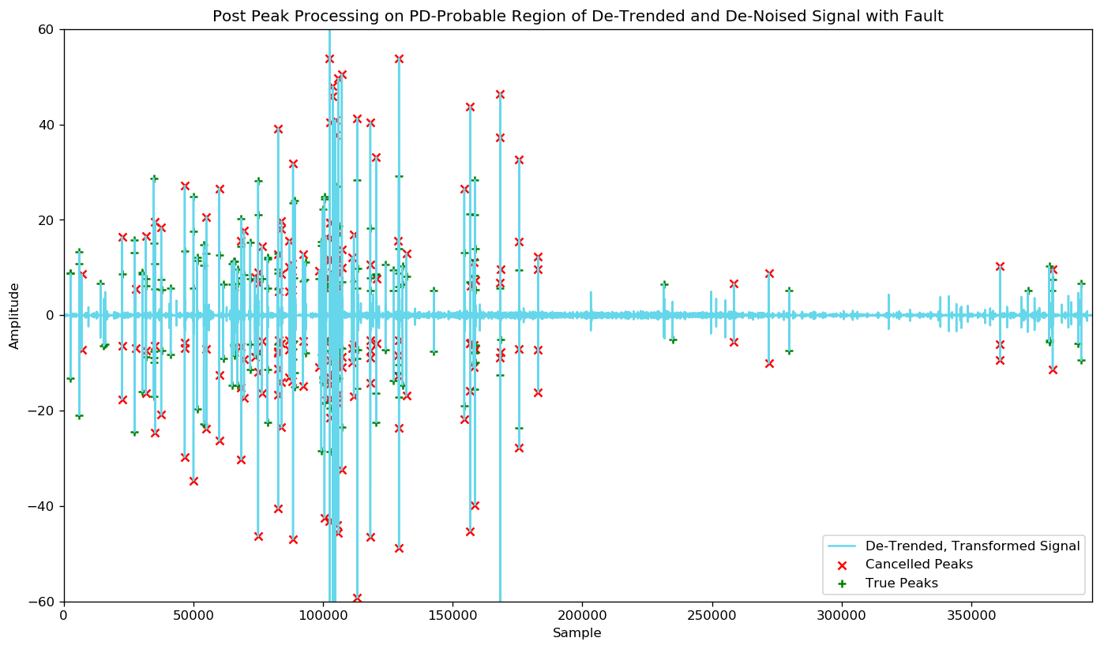
Cancel False Peaks Before Processing Signals

Slide 28
Perform Feature Extraction on Signal
Process the PD-Probable Region of the De-Trended, De-Noised Signal and Build a Feature Table to be used as Input to Machine Learning Models.
5th Percentile
25th Percentile
75th Percentile
95th Percentile
Median
Mean
Standard Deviation
Variance
Root Mean Square
Entropy
Number of Zero Crossings
Number of Mean Crossings
Minimum Peak Height
Maximum Peak Height
Minimum Peak Width
Maximum Peak Width
Number of Detected Peaks
Number of True Peaks
Number of True High Peaks
Number of True Low Peaks (Valleys)

Slide 29
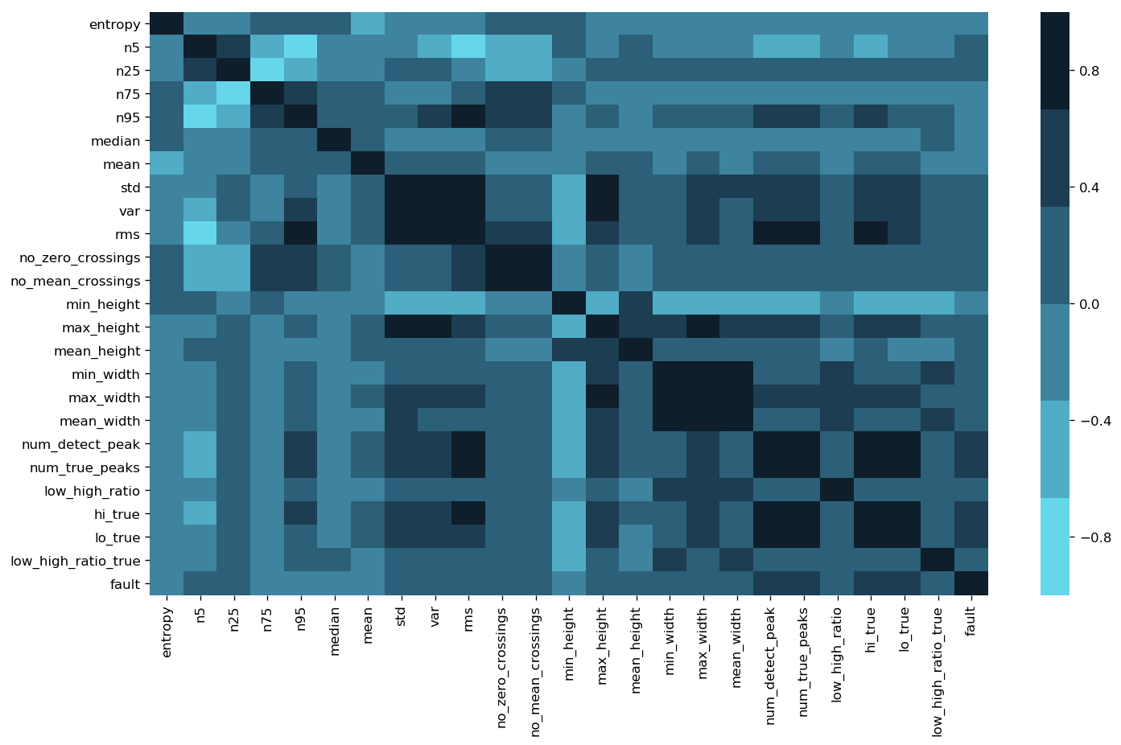
Feature Exploration – Correlation Heat Map

Slide 30
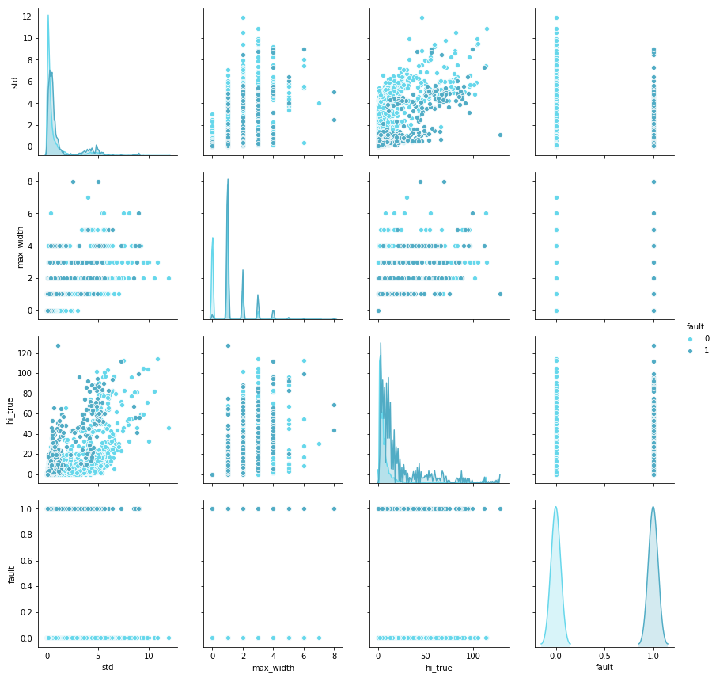
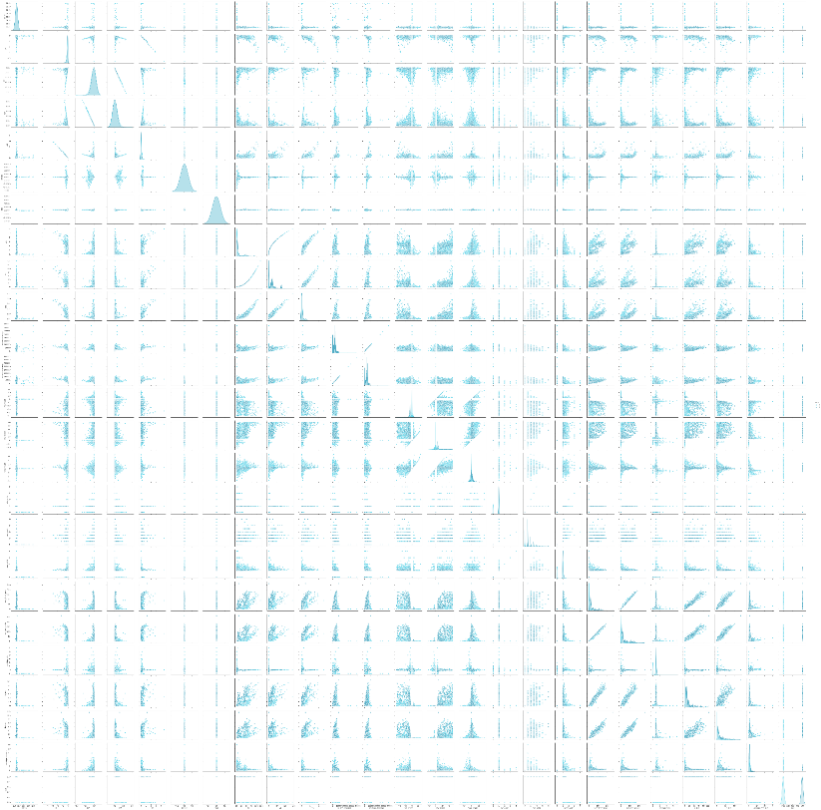
Feature Exploration – Pair Grid to Detect Trends
4x4 Pair Grid to Show Detail
Scatters and KDE
Full 25x25 Pair Grid

Slide 31
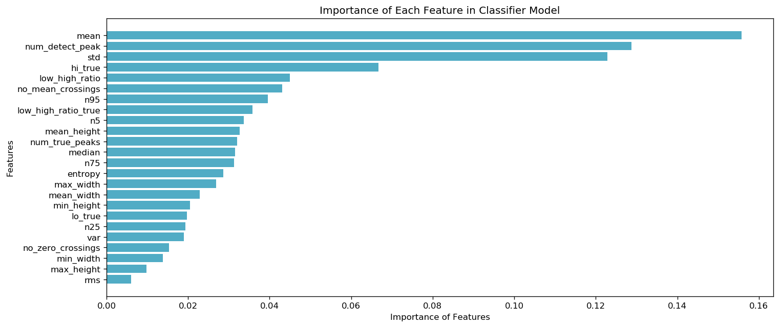
Not All Features are Equally Influential

Slide 32
Prototype Binary Classification Models
At the root of the task is building a Machine Learning model capable of binary classification and this also equally adept at handling unbalanced classes.
k-Nearest Neighbors (k-NN)
Monte Carlo over k parameter
Support Vector Machines (SVM)
Radial Basis Function (rbf) kernel and Monte Carlo over gamma parameter.
Random Forest Decision Trees (RF)
Regarded for handling unbalanced data when tuned properly.
Light Gradient Boosting Framework (LightGBM)
Powerful, tree-based learning algorithm that grows vertically (leaf-wise)
Sensitive to overfitting on small data sets (<10,000 data points)
In binary classification, model returns probability that a sample belongs to the positive class.

Slide 33
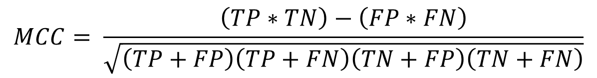
Evaluate Model Performance with MCC
Model performance is evaluated using Matthews Correlation Coefficient (MCC) between the predicted and observed response. The MCC is given by: where TP is the number of true positives, TN the number of true negatives, FP the number of false positives, and FN the number of false negatives.
Matthews Correlation Coefficient is an apt metric to assess a binary classification model, especially one with a highly unbalanced class where metrics like accuracy, precision, and recall don’t adequately capture the effectiveness of a model.
$$MCC= \frac{\left(TP∗TN\right)−\left(FP∗FN\right)}{\sqrt{\left(TP+FP\right)\left(TP+FN\right)\left(TN+FP\right)\left(TN+FN\right)}}$$
Notes:
https://en.wikipedia.org/wiki/Matthews_correlation_coefficient
Can’t use accuracy… if the training data is representative of the larger data population (which you hope it would be), you’d be correct in labeling a sample without fault ~98% of the time. These metrics don’t capture what we’re trying to accomplish in this competition.
MCC is also the metric employed by the competition organizers.

Slide 34
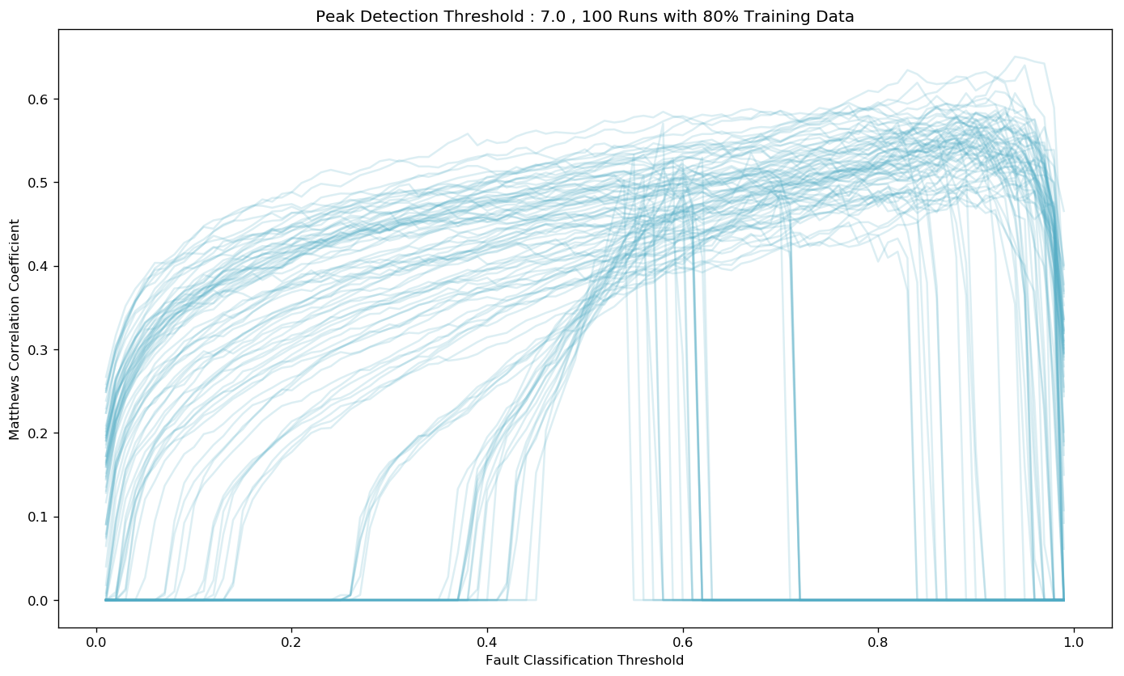
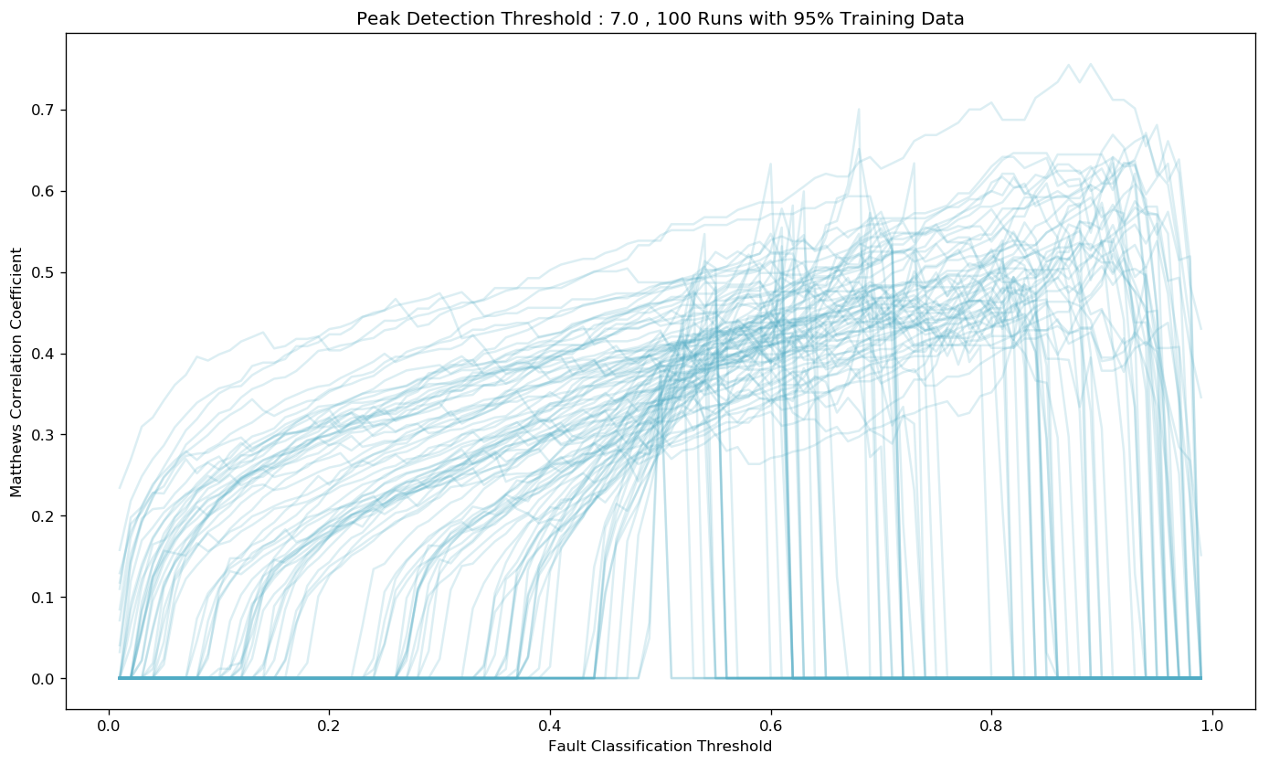
Concerns with Training/Test Splits on Unbalanced Data
Perform Monte Carlo trials that vary the random_state and test_size parameters in sklearn’s train_test_split function and assess the impact of different thresholds on performance.
The goal is to find and set thresholds for Peak Detection and Fault Classification that routinely yield higher Matthews Correlation Coefficient scores and are robust to varied divisions of the training data.
Notes:
Initial submissions proved less than spectacular, my localized training used a fixed random_state (my usual preference for repeatability) that happened to put me at the high end of these types of plots.
I has also used a standard 80-20 split, …
Goal here was to find some thresholds (both for peak detection and fault classification) that routinely yielded greater MCC scores and that was robust to varied splitting of the training data.

Slide 35
Revisiting Random Forest – Tuning for Unbalanced Classes
Use Ensemble k-Fold Cross-Validation
Splits the data into k parts, Take k-1 parts as training data and 1 part for validation
Train and predict with the model k times over, holding out a different part each time.
Ensemble output produces probability of sample belonging to a class, not assignment
Average and use the prediction probabilities from the k scores to assign a class
Set and Tune Class Weights
Enables cost-sensitive learning to remove a bias favoring the dominant class
Impose a costly penalty on minority class misclassification
Initially set weights based on ratios of data points in each class
Iterations on tailoring the weights can improve model performance
Adjust Thresholds on Classification Probabilities to Over/Under Predict a Class
Another method to improve minority class performance
Adjust probability thresholds for making a classification

Slide 36
Use k-Fold CV to Ensure Model Robustness to Test/Train Splits
Use Ensemble k-Fold Cross-Validation to Validate Model Robustness to Test-Train Splits
Splits the data into k parts, Take k-1 parts as training data and 1 part for validation
Train and predict with the model k times over, holding out a different part each time.
Ensemble output produces probability of sample belonging to a class, not assignment
Average and use the prediction probabilities from the k scores to assign a class
k=1
k=2
k=3
k=4
k=5
Train
Train
Train
Train
Test
An example of 5-fold Cross Validation.
For each iteration, fit the model on the training folds and evaluate it using the test fold.
Retain the evaluation scores and probabilities between iterations but discard the trained model.
Train
Train
Train
Test
Train
Train
Train
Test
Train
Train
Train
Test
Train
Train
Train
Test
Train
Train
Train
Train

Slide 37
Modify Class Weights used in Model Training to Remove Bias
Set and Tune Class Weights
Enables cost-sensitive learning to remove a bias favoring the dominant class
Impose a costly penalty on minority class misclassification
Initially set weights based on ratios of data points in each class
Iterations on tailoring the weights can improve model performance
Example from this Project
Default Weights are Uniform:
class_weight = dict({0:1.0, 1:1.0}) # default weights
Initial set the weights based on ratio of samples in training data.
Recall 213 / 8712 signals have faults present thus set fault weight 8499/2134 = 39.90
class_weight = dict({0:1.0, 1:39.9}) # initial, adjusted weights
Iterate and optimize weights through Monte Carlo analysis
class_weight = dict({0:0.5, 1:2.0}) # optimized, adjusted weights

Slide 38
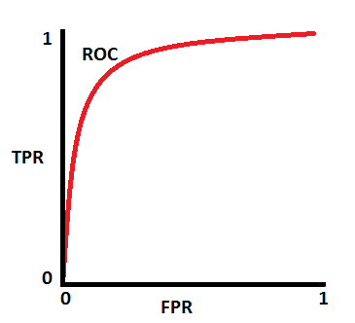
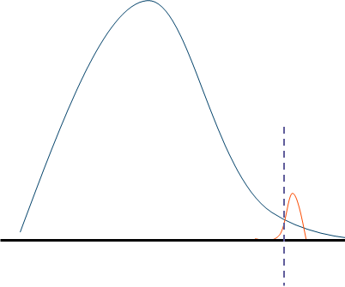
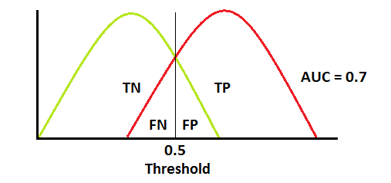
Adjust Probability Thresholds Used to Predict a Class
Adjust Thresholds on Classification Probabilities to Over/Under Predict a Class
Another method to improve minority class performance
Default threshold is 0.5 for binary classification,
Use sklearn.metrics.roc_curve to find and set more appropriate thresholds
fpr, tpr, thresholds = metrics.roc_curve(y, y_prob, pos_label=1)
In the final Partial Discharge detection model, the threshold is set to 0.85
Still Exaggerated but Curves More Representative of PD Data
Example ROC & Threshold

Slide 39
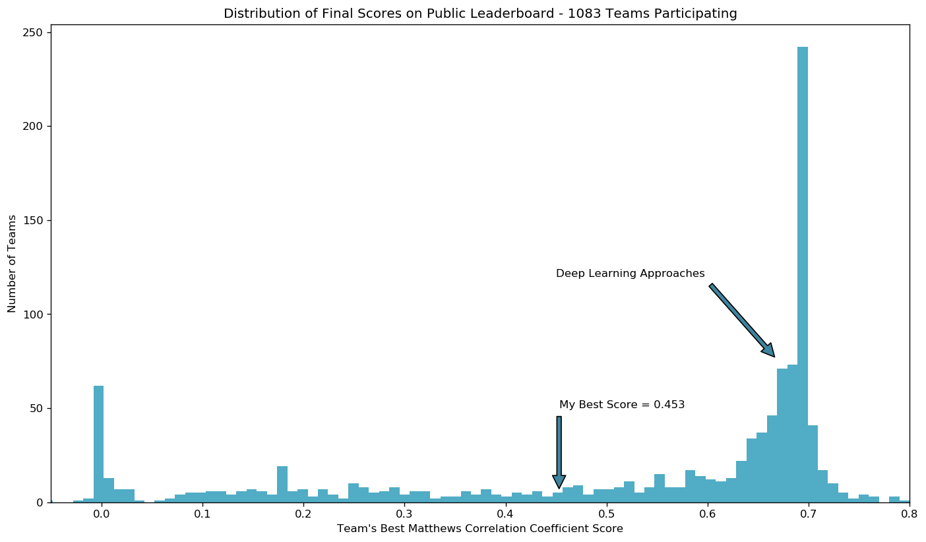
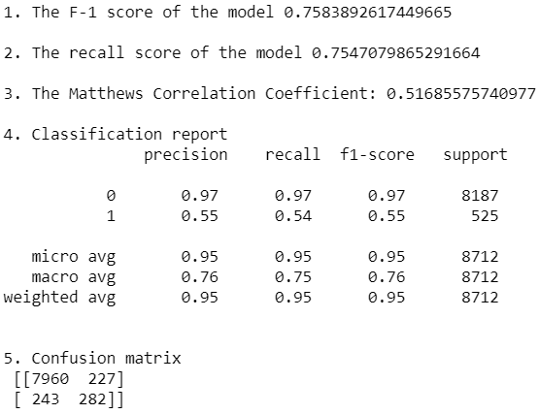
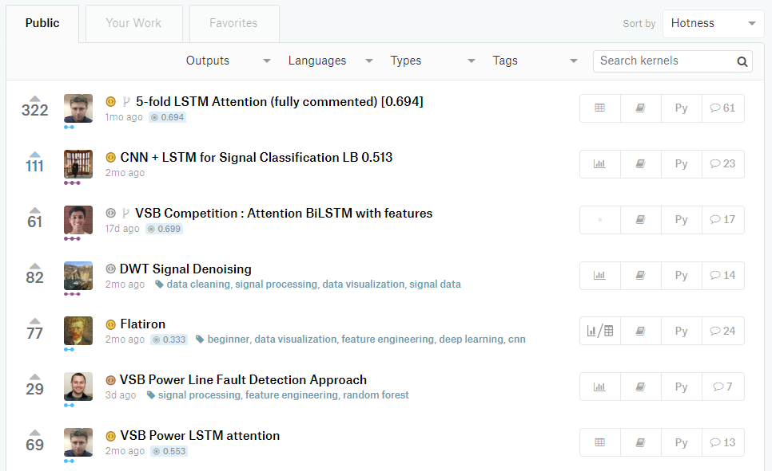
(Nearly) Final Results and Performance
My Predicted Performance
Users replicating a successful approach
(Mostly LSTM)
Trending Kernels for this Project
Top Scores
0.800
0.788
0.786

Slide 40
Key Lessons for Dealing with Unbalanced Classes
Use the right performance metric
Traditional metrics like accuracy, precision, recall, and F1 scores can be misleading
Matthews Correlation Coefficient – an effective binary classification performance measure - even for classes of very different sizes.
Pearson’s Chi-Squared Test - a similar metric for higher order classification problems
Account for the influence of test-train splits
With so few samples belonging to one of the classes, results can vary wildly
Rerun your analysis and testing while varying splits and random states to find robust performance predictions.
Use a model or framework built for the task, and tune it properly
Some models are more adept at handling unbalanced classes than others
Modify and iterate on the impact of class weights, don’t rely on defaults
Ensemble Cross-Validation – robust test-train splits, produces probabilities not classes
Use Probabilities of Class Assignment to Under or Over Predict a Class

Slide 41
Possible Paths to Improvement on this Project
Move from Detection in Single Cycles to an Accumulator or N-Cycle Detection
Detect persistent faults while mitigating sporadic effects like corona
Data should already exist: signal data is device or location tagged
While not globally true, when a fault is present in one phase, the likelihood of fault present in one or both or the other phases is also quite high.
Implement some logic that weights the probability of detection in the aggregate of the measurement?
How to use this data without introducing bias?
Improved signal processing and feature extraction
Further steps to mitigate mitigate suspected overfitting
Avoid feature extraction, and evaluate deep learning methods like LTSM

Slide 42
References – Useful Academic Papers on the Subject
Misak, S., et al. “A Complex Classification Approach of Partial Discharges from Covered Conductors in Real Environment.” IEEE Transactions on Dielectrics and Electrical Insulation, vol. 24, no. 2, 2017, pp. 1097–1104., doi:10.1109/tdei.2017.006135.
Vantuch, Tomas. Analysis of Time Series Data, 2018, dspace.vsb.cz/bitstream/handle/10084/133114/VAN431_FEI_P1807_1801V001_2018.pdf.
My Kaggle kernel and GitHub repos have been set public:
Kaggle Kernel: https://www.kaggle.com/jeffreyegan/vsb-power-line-fault-detection-approach
GitHub: https://github.com/jeffreyegan/VSB_Power_Line_Fault_Detection
Forks & collaboration welcome!

Slide 43

Q: What’s Next? A: More DSP / ML challenges!
Predicting Earthquakes for Los Alamos National Labs – Geophysics Group!
Forecasting earthquakes is one of the most important problems in Earth science because of their devastating consequences. Current scientific studies related to earthquake forecasting focus on three key points: when the event will occur, where it will occur, and how large it will be.
In this competition, you will address when the earthquake will take place. Specifically, you’ll predict the time remaining before laboratory earthquakes occur from real-time seismic data.
https://www.kaggle.com/c/LANL-Earthquake-Prediction

